Slide 1

Microsoft Teams
A (Very) brief introduction

Slide 2
― what is Microsoft Teams? ―
Microsoft Teams is a cloud-based team collaboration software that is part of the Office 365 suite.
With Microsoft Teams on your PC, Mac, or mobile device, you can:
Pull together a team.
Use chat instead of email.
Securely edit files at the same time.
See likes, @mentions, and replies with just a single tap.
Customize it by adding notes, web sites, and apps.

Slide 3

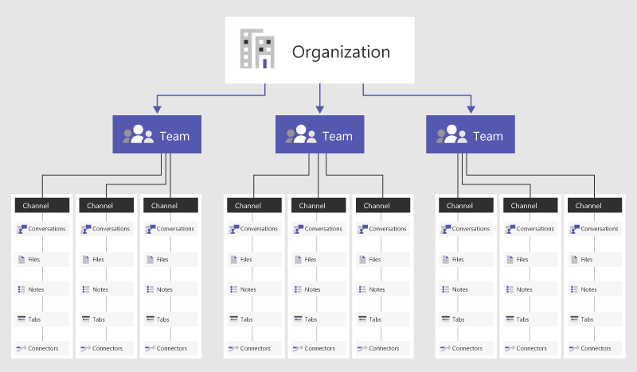
― MS teams structure ―
Only create Channels when you know you really need them
In Microsoft Teams, teams are groups of people brought together for work, projects, or common interests.
Teams are made up of channels. Each channel is built around a topic, like “Team Events,” a department name, or just for fun. Channels are where you hold meetings, have conversations, and work on files together.
The tabs at the top of each channel link to your favorite files, apps, and services.

Slide 4
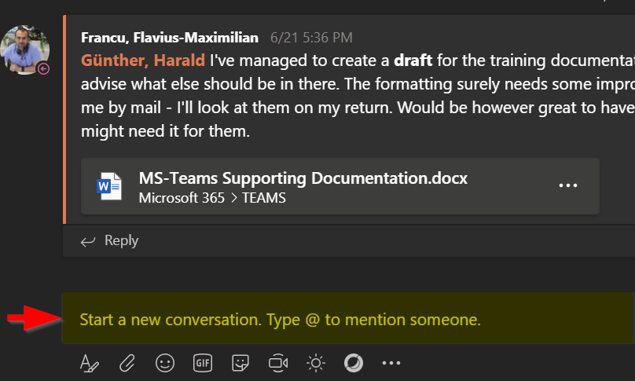
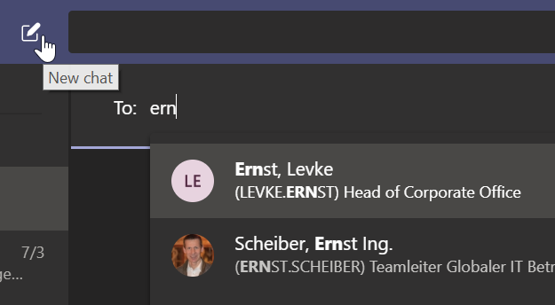
― Chat conversations ―
Try to keep messages short and concise.
Start a new conversation...
...with the whole team
Click Teams , then pick a team and a channel.
In the compose box, say what's on your mind and click Send .
...with a person or group
At the top of the app, click New chat .
In the To field, type the name of the person or people you want to chat with.
In the compose box, say what you have to say and click Send .

Slide 5
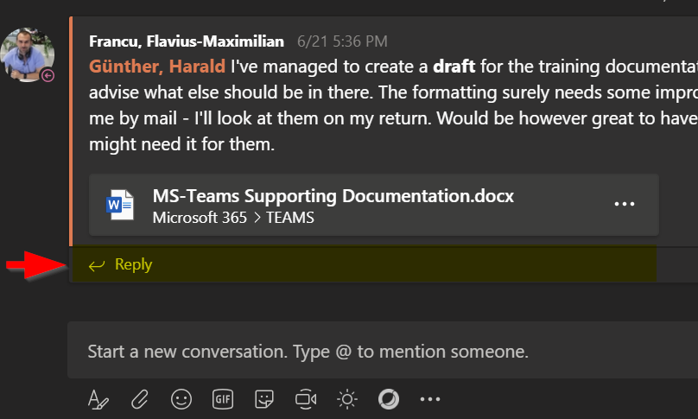
― Chat conversations - reply ―
Don’t mix up Start a conversation with Reply to a conversation
Reply to a conversation
Channel conversations are organized by date and then threaded. The replies in threads are organized under the initial post so it's easier to follow multiple conversations.
Find the conversation thread you want to reply to.
Click Reply, add your message, and click Send .

Slide 6
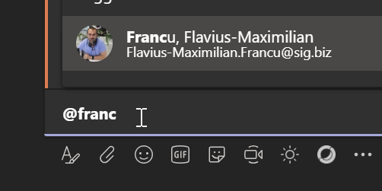
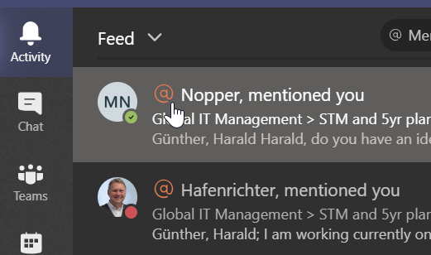
― Chat conversations – @mention ―
Don’t @mention a Team or Channel unless you really need to
@mention someone
An @mention is like a tap on the shoulder—a way to get someone's attention in a channel conversation or a chat.
In the compose box, type @, then type the first few letters of the person’s name. You can also @mention entire teams and channels.
Select the person. Repeat for as many people as you want to @mention. Say what you have to say and click Send
Each person you @mention gets a notification in their Activity feed. Check for a red circle next to Activity to see if someone has @mentioned you!

Slide 7
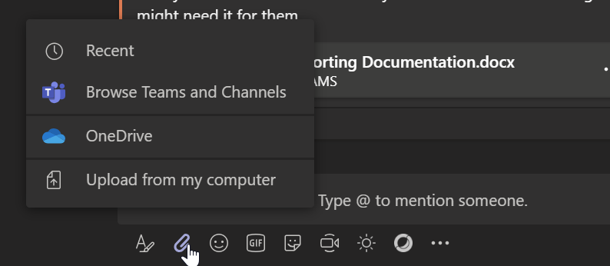
― Chat conversations – Share A file ―
Share a file
Sometimes words aren't enough, and you need to post a file to a channel conversation.
In your channel conversation, click Attach beneath your compose box.
Select a file, click Open, and then Send .
You can always see all the files you post to a channel by going to the Files tab.

Slide 8
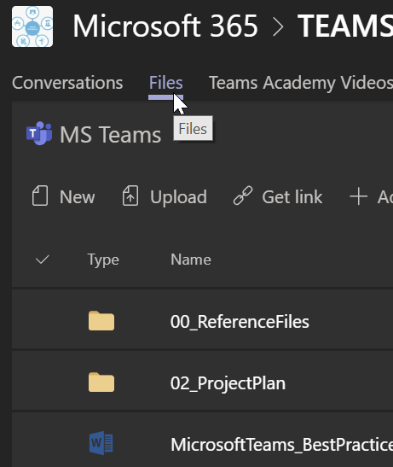
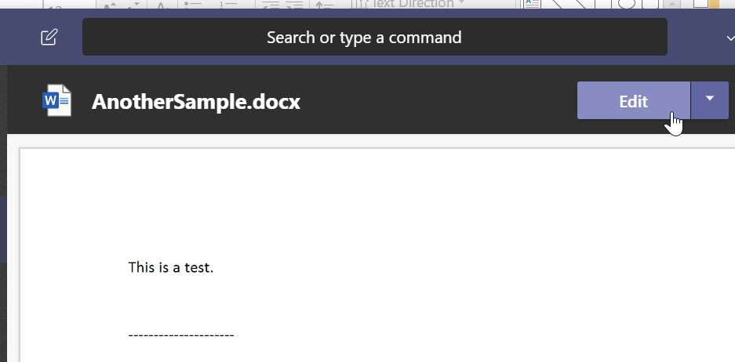
― Working with THE files tab ―
Keep files under 15 GB in size.
Limit to three levels of folders deep
Every chat and channel has a Files tab where you will find everything that’s been shared there.
Create new Office files or folders by going to the Files tab and clicking New. You can create folders, Word, Excel or PowerPoint files directly from here. The Office files will be created with the Office Online apps.
Upload a file by going to the Files tab and clicking Upload. You can select one or more files from your computer to be uploaded.
View files by simply clicking on the file name. A preview of the file content will appear. If you choose to edit the file click Edit in the preview.

Slide 9
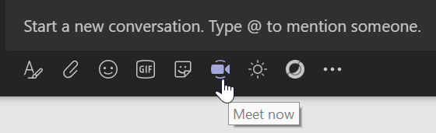

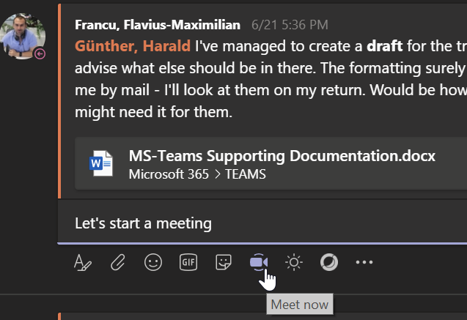

― instant meetings with Meet now ―
Turn a conversation into a meeting with a few clicks. Add audio, video, and share your screen.
To start a meeting, do one of the following:
Select in a new conversation.
Select in an existing conversation to keep all that conversation’s context.
In your video preview, enter a name for the meeting, and select Meet now.
Select the names of the team members you want to invite to the meeting.
Select the share screen icon to show your screen to the other people in the meeting.

Slide 10
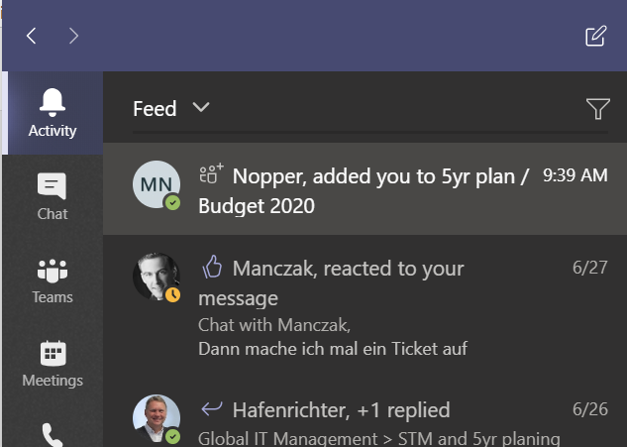
― Activity usage ―
Stay on top of things
Notifications let you know when someone @mentions you, likes something you’ve posted, or replies to a thread you started. The Activity feed helps you stay on top of all your notifications.
Click Activity .
Feed shows you a summary of everything that's happened in the channels you follow.
Click Filter to show only certain types of notifications such as @mentions or likes.

Slide 11
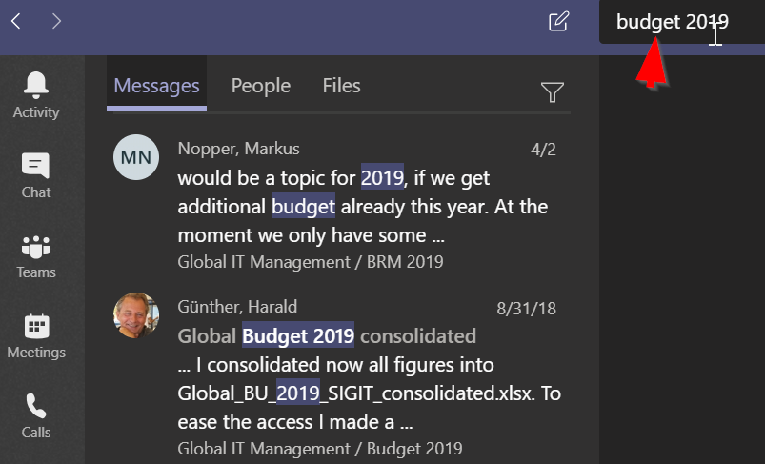
― Search ―
Search for messages, people, or files
Searches cover your entire organization—all the teams and channels that you are part of.
Type a phrase in the command box at the top of the app and press Enter.
Select the Messages, People, or Files tab.
Select an item in the search results. Alternatively, you can click Filter to further refine your search results.

Slide 12
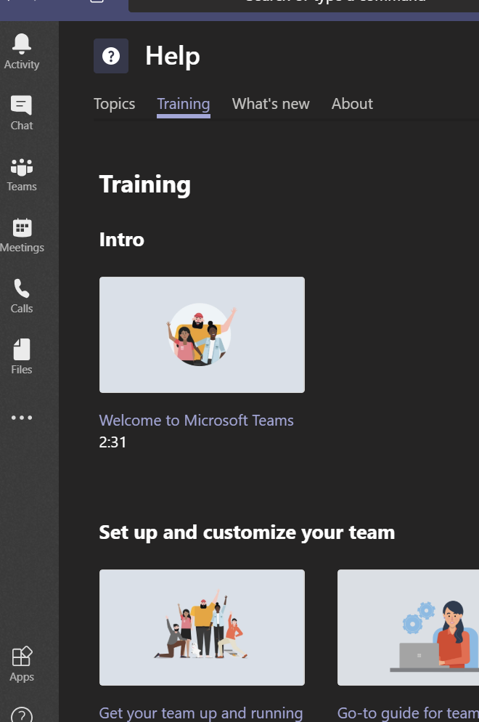
― Help ―
Get help
Got a question about Teams?
Click Help on the left side of the app, then pick one of the following:
Browse Topics to see what's already out there.
Training to access short introductory videos
What's new to see the latest and greatest.

Slide 13


